Slide 1
Project Status Report Business Intelligence System
Guide Jaganathan M
Prof Sheik Abdullah 56135

Slide 2
About
Managed Accounts
Managed Investments
Security Features
User Experience
Tools Used

Slide 3
Problem Description
Security features of an application such as authenticating the user who logs in, granting specific permissions to access the data based on the type of user.
Enhancing User experience by showing only the results and data what the user wants to know exactly.

Slide 4
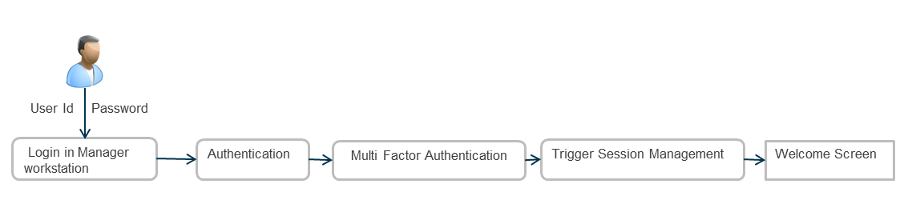
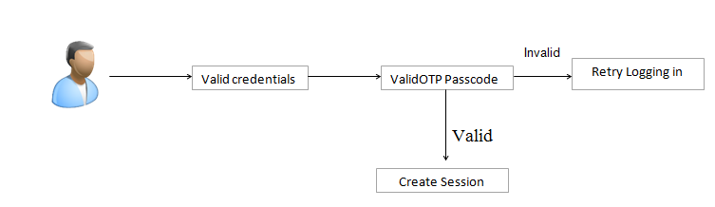
Authentication

Slide 5
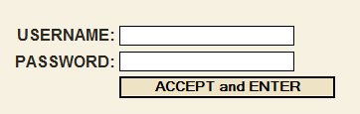
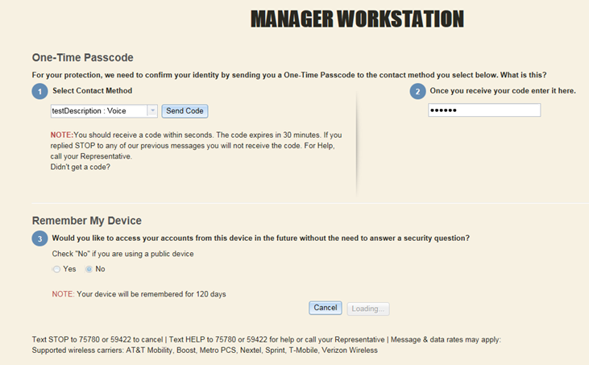
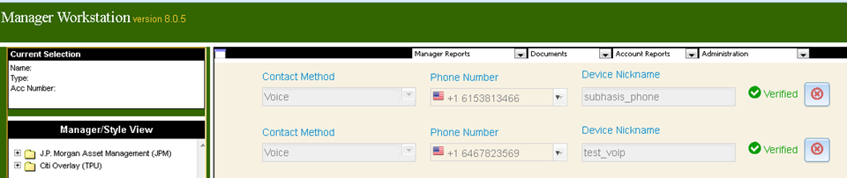
Screenshots

Slide 6
User Experience
Types of Users

Slide 7
Use Case Diagram for User’s Functions

Slide 8
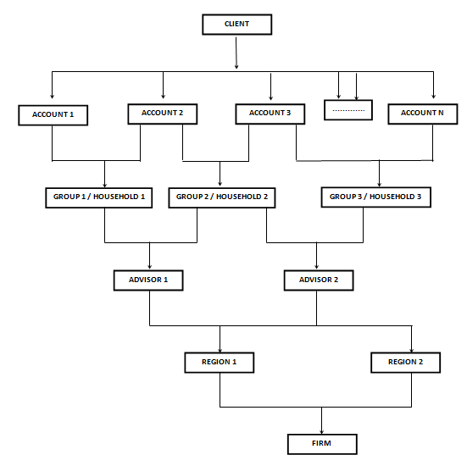
Tree View

Slide 9
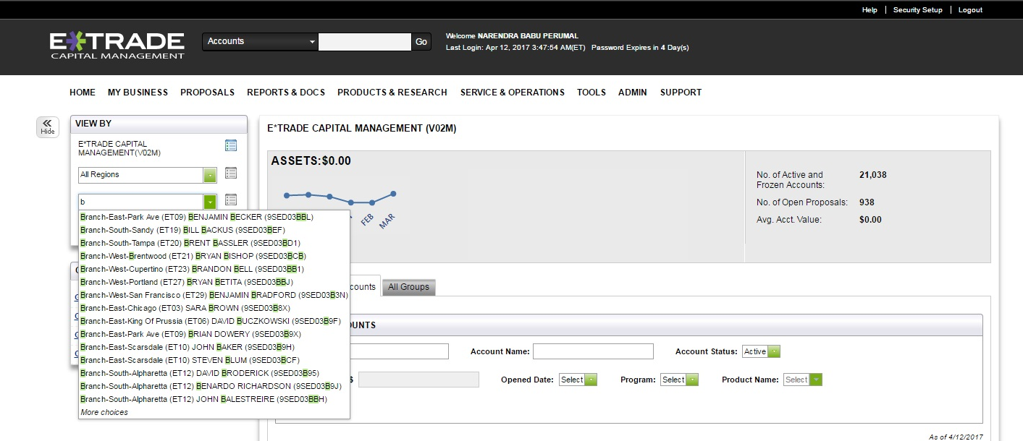
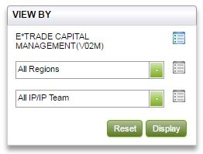
Lucene Search

Slide 10
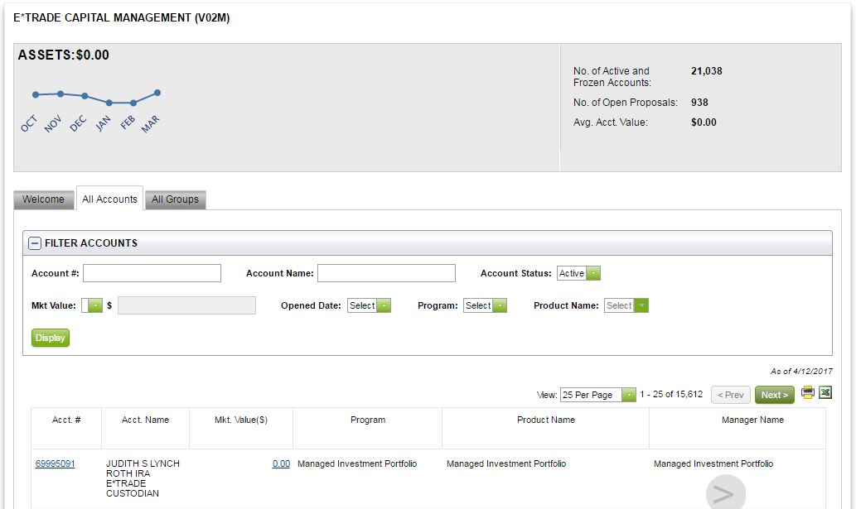
Report Generation
Export to PDF
Export to EXCEL
Selected Accounts with Selected Columns that user wants
Filter Records based on partial information

Slide 11
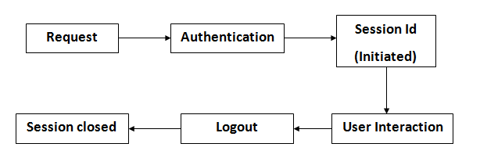
Session Management
15 Hours Maximum of time for an active session
20 mins of idle time
Alert at 18 inactive minutes

Slide 12
Tool learned & used
GIT -- Code Repository
Jenkins -- Project Build Tool
SonarQube -- Code Quality Checking
Selenium -- UI Testing

Slide 13
Thank you!

